Slide 1

Database Systems:
Design, Implementation, and Management
Ninth Edition
Chapter 9
Database Design

Slide 2
Objectives
In this chapter, you will learn:
That successful database design must reflect the information system of which the database is a part
That successful information systems are developed within a framework known as the Systems Development Life Cycle (SDLC)
Database Systems, 9th Edition

Slide 3
Objectives (cont’d.)
That within the information system, the most successful databases are subject to frequent evaluation and revision within a framework known as the Database Life Cycle (DBLC)
How to conduct evaluation and revision within the SDLC and DBLC frameworks
About database design strategies: top-down vs. bottom-up design and centralized vs. decentralized design
Database Systems, 9th Edition

Slide 4
The Information System
Provides for data collection, storage, and retrieval
Composed of:
  People, hardware, software
  Database(s), application programs, procedures
Systems analysis
  Process that establishes need for and extent of information system
Systems development
  Process of creating information system
Database Systems, 9th Edition

Slide 5
The Information System (cont’d.)
Applications
  Transform data into information that forms basis for decision making
  Usually produce the following:
    Formal report
    Tabulations
    Graphic displays
  Composed of the following two parts:
    Data
    Code: program instructions
Database Systems, 9th Edition

Slide 6
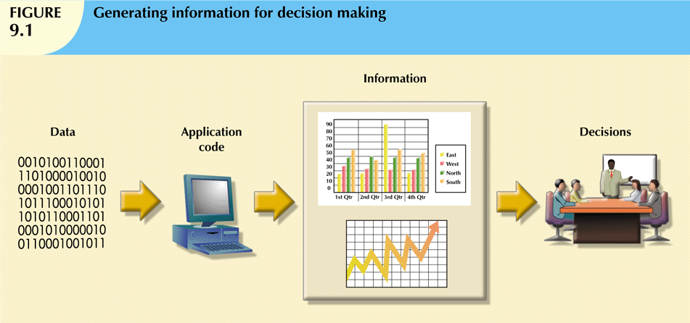
Database Systems, 9th Edition

Slide 7
The Information System (cont’d.)
Performance depends on three factors:
  Database design and implementation
  Application design and implementation
  Administrative procedures
Database development
  Process of database design and implementation
  Implementation phase includes:
    Creating database storage structure
    Loading data into the database
    Providing for data management
Database Systems, 9th Edition

Slide 8
The Systems Development Life Cycle (SDLC)
Traces history (life cycle) of information system
Database design and application development mapped out and evaluated
Divided into following five phases:
  Planning
  Analysis
  Detailed systems design
  Implementation
  Maintenance
Iterative rather than sequential process
Database Systems, 9th Edition

Slide 9
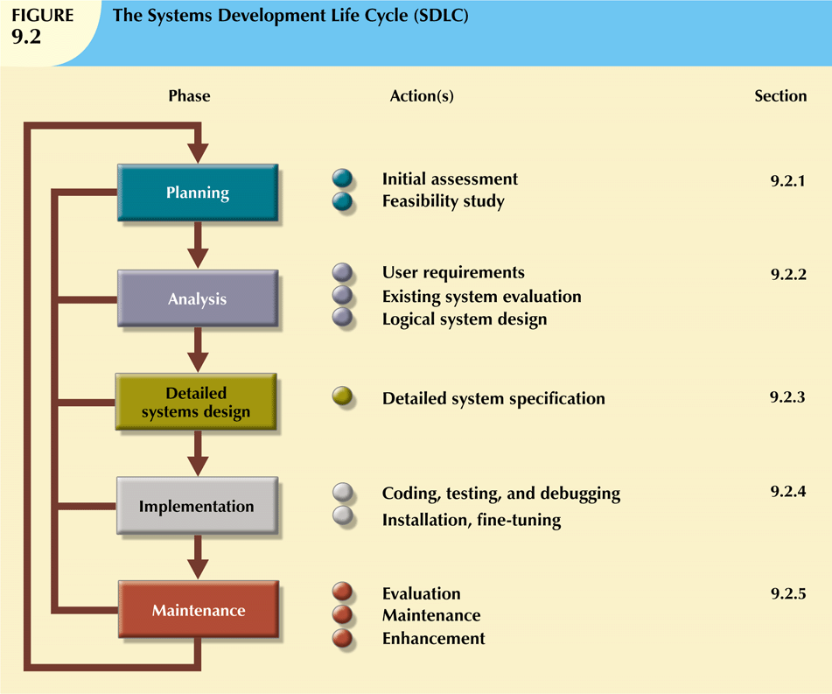
Database Systems, 9th Edition

Slide 10
Planning
General overview of company and objectives
Assessment of flow-and-extent requirements
  Should the existing system be continued?
  Should the existing system be modified?
  Should the existing system be replaced?
Study and evaluate alternate solutions
  Technical aspects of hardware and software requirements
  System cost
  Operational cost
Database Systems, 9th Edition

Slide 11
Analysis
Problems defined during planning phase are examined in greater detail during analysis
Thorough audit of user requirements
Existing hardware and software systems are studied
Goal:
  Better understanding of:
    System’s functional areas
    Actual and potential problems
    Opportunities
Database Systems, 9th Edition

Slide 12
Detailed Systems Design
Designer completes design of system’s processes
Includes all necessary technical specifications
Steps laid out for conversion from old to new system
Training principles and methodologies are also planned
  Submitted for management approval
Database Systems, 9th Edition

Slide 13
Implementation
Hardware, DBMS software, and application programs are installed
  Database design is implemented
Cycle of coding, testing, and debugging continues until database is ready for delivery
Database is created and system is customized
  Creation of tables and views
  User authorizations
Database Systems, 9th Edition

Slide 14
Maintenance
Three types of maintenance activity:
  Corrective maintenance
  Adaptive maintenance
  Perfective maintenance
Computer-aided systems engineering (CASE)
  Produce better systems within reasonable amount of time and at reasonable cost
  CASE-produced applications are structured, documented, and standardized
Database Systems, 9th Edition

Slide 15
The Database Life Cycle (DBLC)
Six phases:
  Database initial study
  Database design
  Implementation and loading
  Testing and evaluation
  Operation
  Maintenance and evolution
Database Systems, 9th Edition

Slide 16
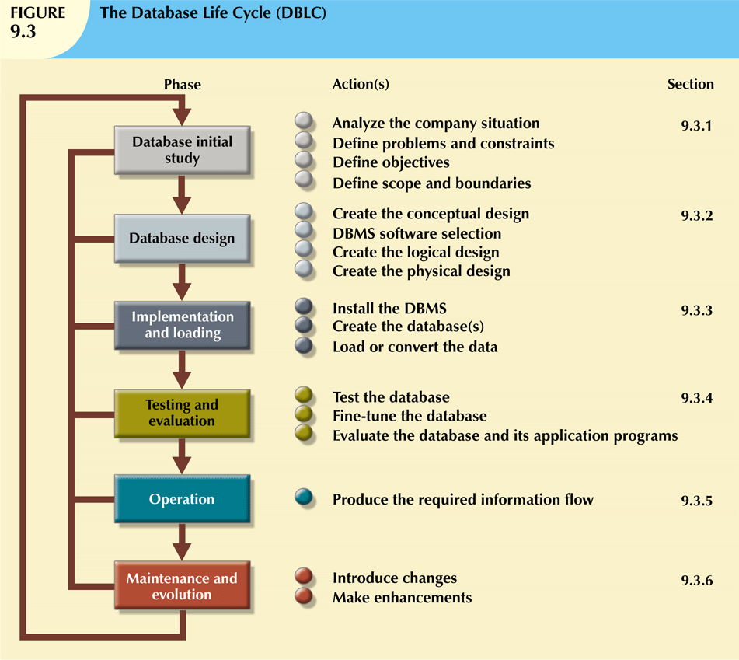
Database Systems, 9th Edition

Slide 17
The Database Initial Study
Overall purpose:
  Analyze company situation
  Define problems and constraints
  Define objectives
  Define scope and boundaries
Interactive and iterative processes required to complete first phase of DBLC successfully
Database Systems, 9th Edition

Slide 18
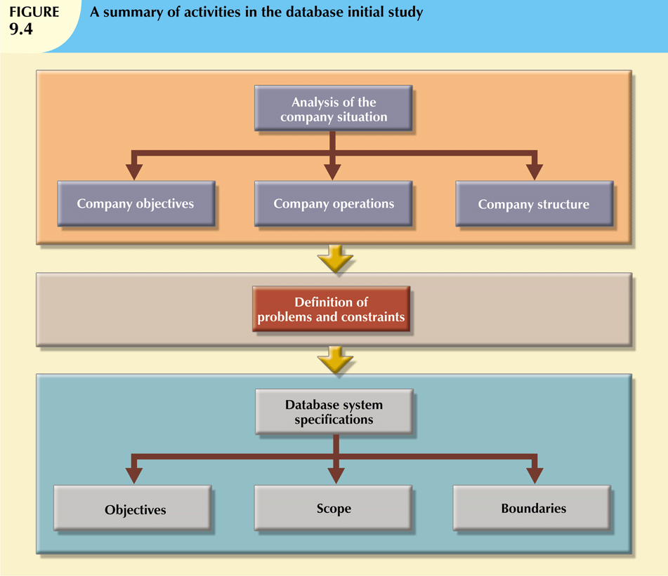
Database Systems, 9th Edition

Slide 19
The Database Initial Study (cont’d.)
Analyze the company situation
  General conditions in which company operates, its organizational structure, and its mission
  Discover what company’s operational components are, how they function, and how they interact
Database Systems, 9th Edition

Slide 20
The Database Initial Study (cont’d.)
Define problems and constraints
  Formal and informal information sources
  Finding precise answers is important
  Accurate problem definition does not always yield a solution
Database Systems, 9th Edition

Slide 21
The Database Initial Study (cont’d.)
Database system objectives must correspond to those envisioned by end users
  What is proposed system’s initial objective?
  Will system interface with other systems in the company?
  Will system share data with other systems or users?
Scope: extent of design according to operational requirements
Boundaries: limits external to system
Database Systems, 9th Edition

Slide 22
Database Design
Necessary to concentrate on data characteristics required to build database model
Two views of data within system:
  Business view
    Data as information source
  Designer’s view
    Data structure, access, and activities required to transform data into information
Database Systems, 9th Edition

Slide 23
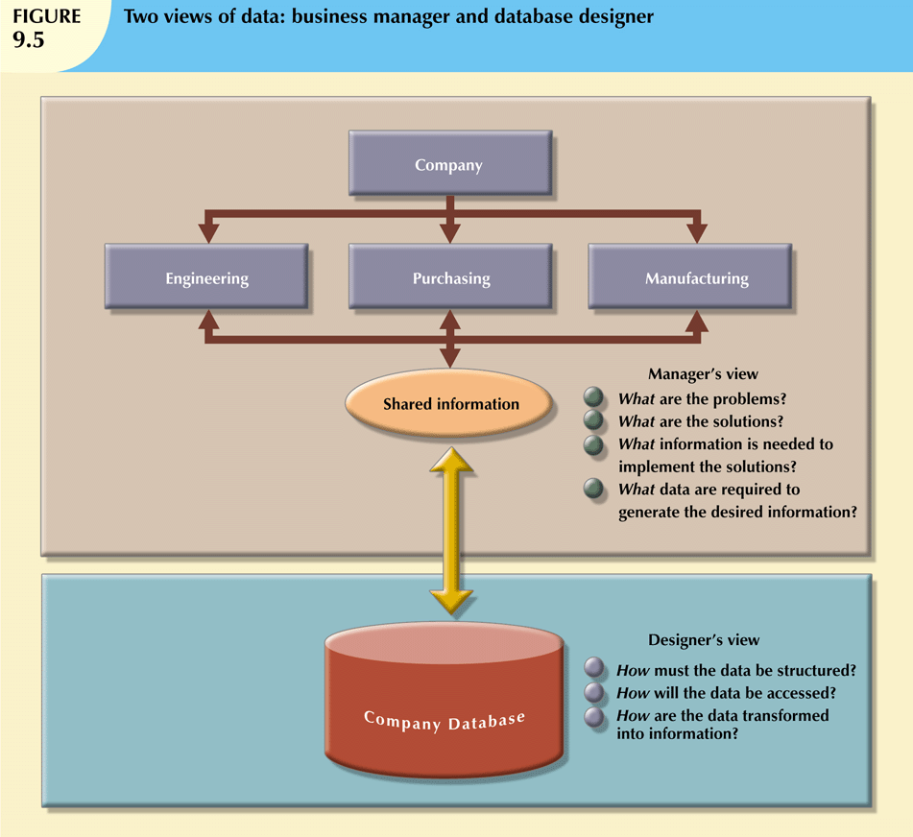
Database Systems, 9th Edition

Slide 24
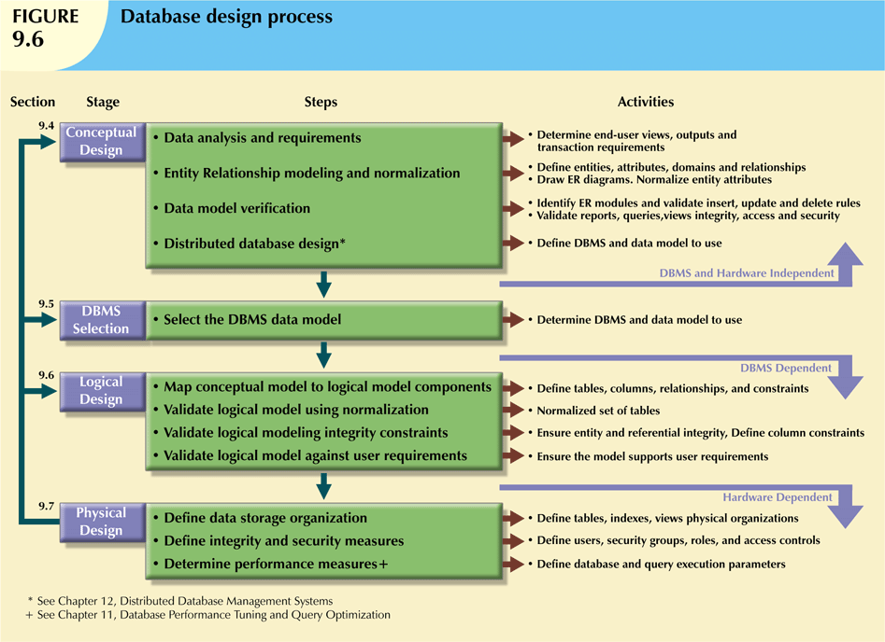
Database Systems, 9th Edition

Slide 25
Implementation and Loading
Actually implement all design specifications from previous phase:
  Install the DBMS
    Virtualization: creates logical representations of computing resources independent of physical resources
  Create the Database
  Load or Convert the Data
Database Systems, 9th Edition

Slide 26
Testing and Evaluation
Occurs in parallel with applications programming
Database tools used to prototype applications
If implementation fails to meet some of system’s evaluation criteria:
  Fine-tune specific system and DBMS configuration parameters
  Modify physical or logical design
  Upgrade software and/or hardware platform
Database Systems, 9th Edition

Slide 27
Testing and Evaluation
(cont’d.)
Integrity
  Enforced via proper use of primary, foreign key rules
Backup and Recovery
  Full backup
  Differential backup
  Transaction log backup
Database Systems, 9th Edition

Slide 28
Operation
Once database has passed evaluation stage, it is considered operational
Beginning of operational phase starts process of system evolution
Problems not foreseen during testing surface
Solutions may include:
  Load-balancing software to distribute transactions among multiple computers
  Increasing available cache
Database Systems, 9th Edition

Slide 29
Maintenance and Evolution
Required periodic maintenance:
  Preventive maintenance (backup)
  Corrective maintenance (recovery)
  Adaptive maintenance
  Assignment of access permissions and their maintenance for new and old users
  Generation of database access statistics
  Periodic security audits
  Periodic system-usage summaries
Database Systems, 9th Edition

Slide 30
Conceptual Design
Data modeling creates an abstract database structure
  Represents real-world objects
Embodies clear understanding of business and its functional areas
Ensure that all data needed are in model, and that all data in model are needed
Requires four steps
Database Systems, 9th Edition

Slide 31
Data Analysis and Requirements
Discover data element characteristics
  Obtains characteristics from different sources
Requires thorough understanding of the company’s data types and their extent and uses
Take into account business rules
  Derived from description of operations
Database Systems, 9th Edition

Slide 32
Entity Relationship Modeling and Normalization
Designer enforces standards in design documentation
  Use of diagrams and symbols, documentation writing style, layout, other conventions
Business rules must be incorporated into conceptual model
ER model is a communications tool as well as design blueprint
Database Systems, 9th Edition

Slide 33
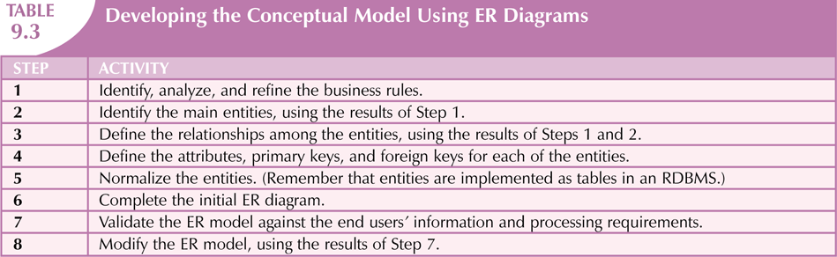
Database Systems, 9th Edition

Slide 34
Data Model Verification
Verified against proposed system processes
Revision of original design
  Careful reevaluation of entities
  Detailed examination of attributes describing entities
Define design’s major components as modules:
  Module: information system component that handles specific function
Database Systems, 9th Edition

Slide 35
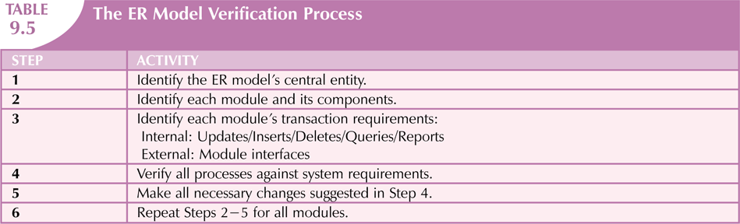
Data Model Verification (cont’d.)
Database Systems, 9th Edition

Slide 36
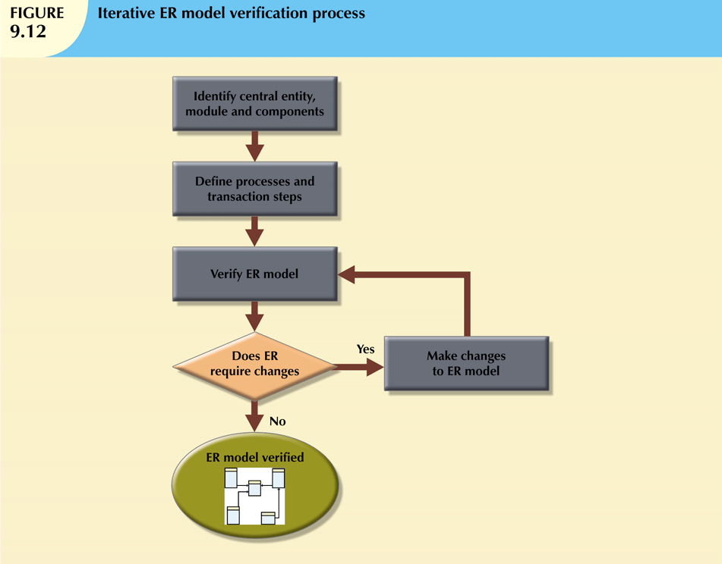
Database Systems, 9th Edition

Slide 37
Distributed Database Design
Portions of database may reside in different physical locations
  Database fragment: subset of a database stored at a given location
Processes accessing the database vary from one location to another
Designer must also develop data distribution and allocation strategies
Database Systems, 9th Edition

Slide 38
DBMS Software Selection
Critical to information system’s smooth operation
Common factors affecting purchasing decisions:
  Cost
  DBMS features and tools
  Underlying model
  Portability
  DBMS hardware requirements
Database Systems, 9th Edition

Slide 39
Logical Design
Map conceptual design to specific data model
Still independent of physical-level details
Requires all objects be mapped to specific constructs used by selected database software
  Definition of attribute domains, design of required tables, access restriction formats
  Tables must correspond to entities in conceptual design
Translates software-independent conceptual model into software-dependent model
Database Systems, 9th Edition

Slide 40
Map the Conceptual Model to the Logical Model
Map the conceptual model to the chosen database constructs
Five mapping steps involved:
  Strong entities
  Supertype/subtype relationships
  Weak entities
  Binary relationships
  Higher degree relationships
Database Systems, 9th Edition

Slide 41
Validate the Logical Model Using Normalization
Translation requires the definition of the attribute domains and appropriate constraints
All defined constraints must be supported by the logical data model
Special attention should be place at this stage to ensure security is enforced
  May have to consider security restrictions at multiple locations
Database Systems, 9th Edition

Slide 42
Validate the Logical Model against User Requirements
Final step in the logical design process
Validate all logical model definitions against all end-user data, transaction, and security requirements
Database Systems, 9th Edition

Slide 43
Physical Design
Process of selecting data storage and data access characteristics of database
Storage characteristics are function of:
  Device types supported by hardware
  Type of data access methods supported by system
  DBMS
More complex when data are distributed
Database Systems, 9th Edition

Slide 44
Define Data Storage Organization
Designer must determine several attributes:
  Data volume
  Data usage patterns
Which in turn influence:
  Location and physical storage organization for each table
  What indexes and the type of indexes to be used for each table
  What views and the type of views to be used on each table
Database Systems, 9th Edition

Slide 45
Define Integrity and Security Measures
Define user and security groups and roles
  Database role: set of database privileges that could be assigned as a unit to a user or group
Assign security controls
  Specific access rights on database objects to a user or group of users
  Can also revoke during operation to assist with backups or maintenance events
Database Systems, 9th Edition

Slide 46
Determine Performance Measures
Performance can be affected by characteristics:
  Storage media
  Seek time
  Sector and block (page) size
  And more…
Fine-tuning the DBMS and queries to ensure that they will meet end-user performance requirements
Database Systems, 9th Edition

Slide 47
Database Design Strategies
Top-down design
  Identifies data sets
  Defines data elements for each of those sets
    Definition of different entity types
    Definition of each entity’s attributes
Bottom-up design
  Identifies data elements (items)
  Groups them together in data sets
Database Systems, 9th Edition

Slide 48
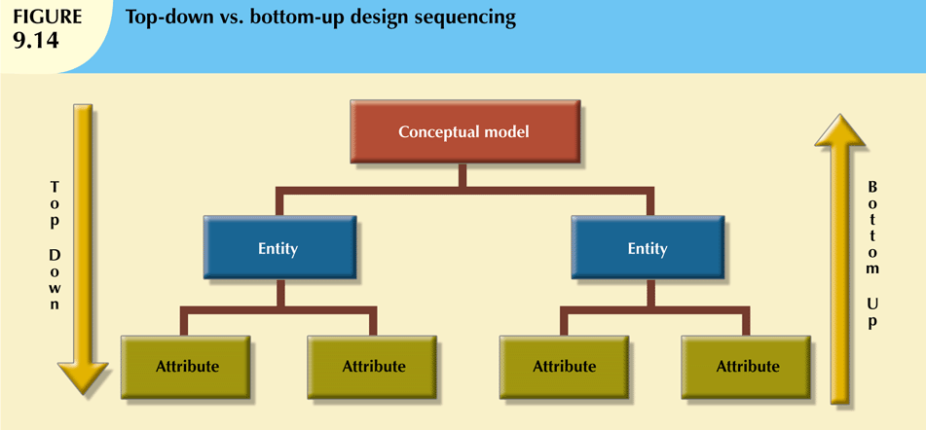
Database Systems, 9th Edition

Slide 49
Centralized vs. Decentralized Design
Centralized design
  When data component is composed of small number of objects and procedures
  Typical of small systems
Decentralized design
  Data component has large number of entities
  Complex relations on which complex operations are performed
  Problem is spread across several operational sites
Database Systems, 9th Edition

Slide 50
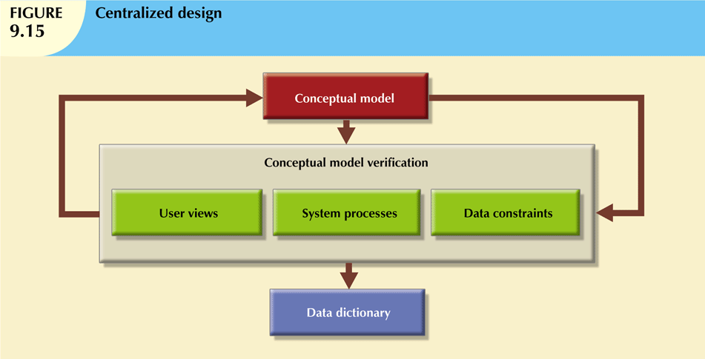
Database Systems, 9th Edition

Slide 51
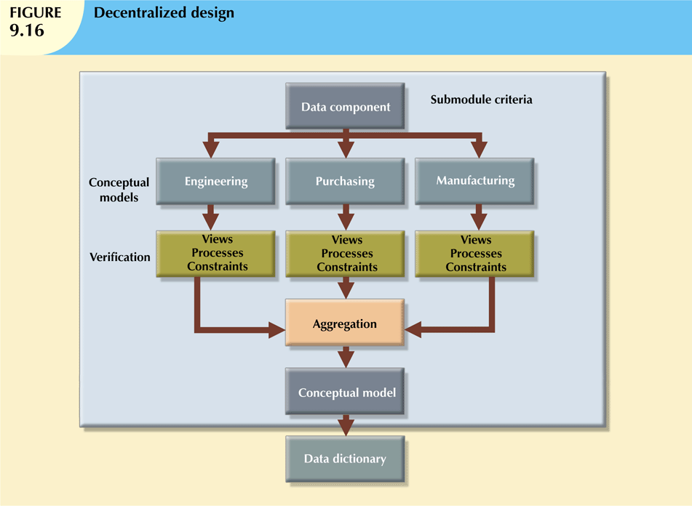
Database Systems, 9th Edition

Slide 52
Centralized vs. Decentralized Design (cont’d.)
All modules are integrated into one model
Aggregation problems to be addressed:
    Synonyms and homonyms
    Entity and entity subtypes
    Conflicting object definitions
Database Systems, 9th Edition

Slide 53
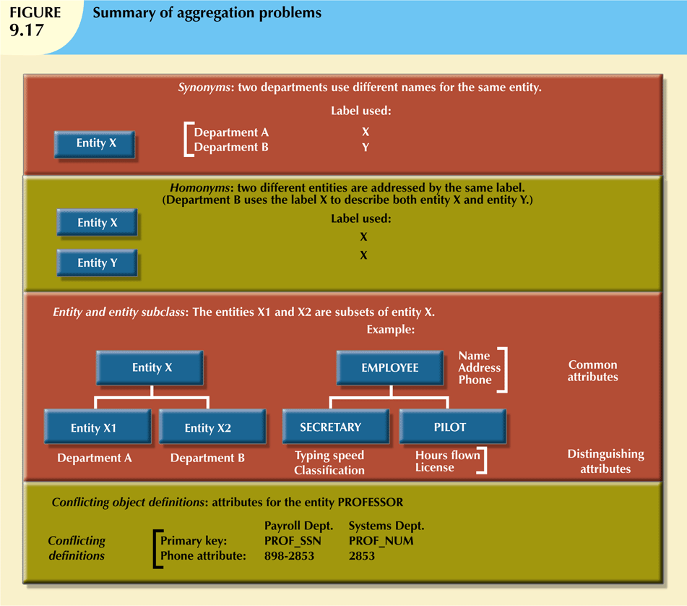
Database Systems, 9th Edition

Slide 54
Summary
Information system facilitates transformation of data into information
  Manages both data and information
SDLC traces history (life cycle) of an application within the information system
DBLC describes history of database within the information system
Database Systems, 9th Edition

Slide 55
Summary (cont’d.)
Database design and implementation process moves through series of well-defined stages
Conceptual design subject to several variations:
  Top-down vs. bottom-up
  Centralized vs. decentralized
Database Systems, 9th Edition

